Slide 1
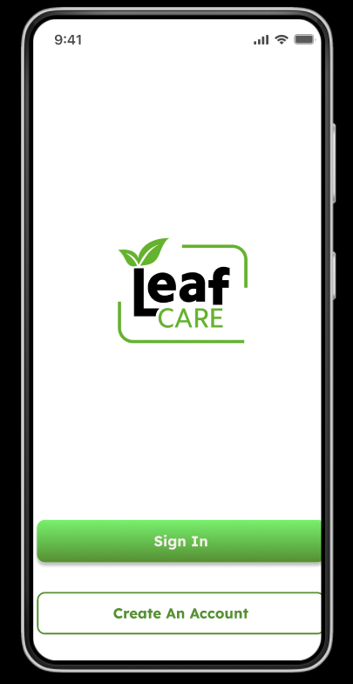
LeafCare
Real-Time Plant Health Detection and Home-Remedy Assistance on Edge Devices
Anuska Palit,
Department of Computer Science & Information Technology
Lovely Professional University, Punjab, India
Page1

Slide 2
The Problem: Plant Care Barriers
Home gardening has surged, yet accessible AI plant diagnostics remain limited. Existing solutions demand large datasets, lack interpretability, and are built for agricultural scale—not everyday home gardeners.
Data Intensive
Agricultural Focus
Limited Transparency
Require extensive labeled datasets for training
Designed for large-scale farming, not home gardens
Black-box models without explainability or real-time capability
Mission: Democratize AI-powered plant diagnostics through interpretable, edge-optimized technology accessible to everyday users.
Page2

Slide 3
Research Objectives & Contributions
Deep Learning Disease Detection
Few-Shot Adaptability
Develop CNN model with attention visualization for plant disease classification and health scoring
Enable rapid learning from minimal examples for unseen diseases through prototypical networks
NLP-Driven Assistant
Privacy-Preserving Edge Deployment
Integrate conversational AI for context-aware home remedies and personalized care advice
Optimize for on-device inference using TensorFlow Lite quantization and model compression
Page3

Slide 4
System Architecture
01
02
03
Image Capture
CNN Feature Extraction
Symptom Attention
Real-time leaf photography via mobile device
MobileNetV2 backbone processes visual features
Spatial and channel-wise weighting highlights disease regions
04
05
Multi-Task Output
Remedy Mapping
Classification, health regression, attention maps simultaneously
NLP-powered conversational assistant provides personalized care
Page4

Slide 5
Deep Learning Architecture
Backbone: MobileNetV2 (lightweight, efficient for mobile deployment)
Core Components
Output Tensors
Feature Extraction: MobileNetV2 backbone
Classification logits (disease type)
Attention Module: Spatial + channel-wise weighting
Health regression (0–100 score)
Prototypical Head: Few-shot embedding vectors
Attention heatmap (disease localization)
Multi-task Decoder: Disease classification, health regression, attention maps
Prototypical embedding (few-shot capability)
Attention Formula: A = softmax(W₁F + W₂F_c)
Total Loss: L_total = L_class + λ₁L_health + λ₂L_attention
Page5

Slide 6
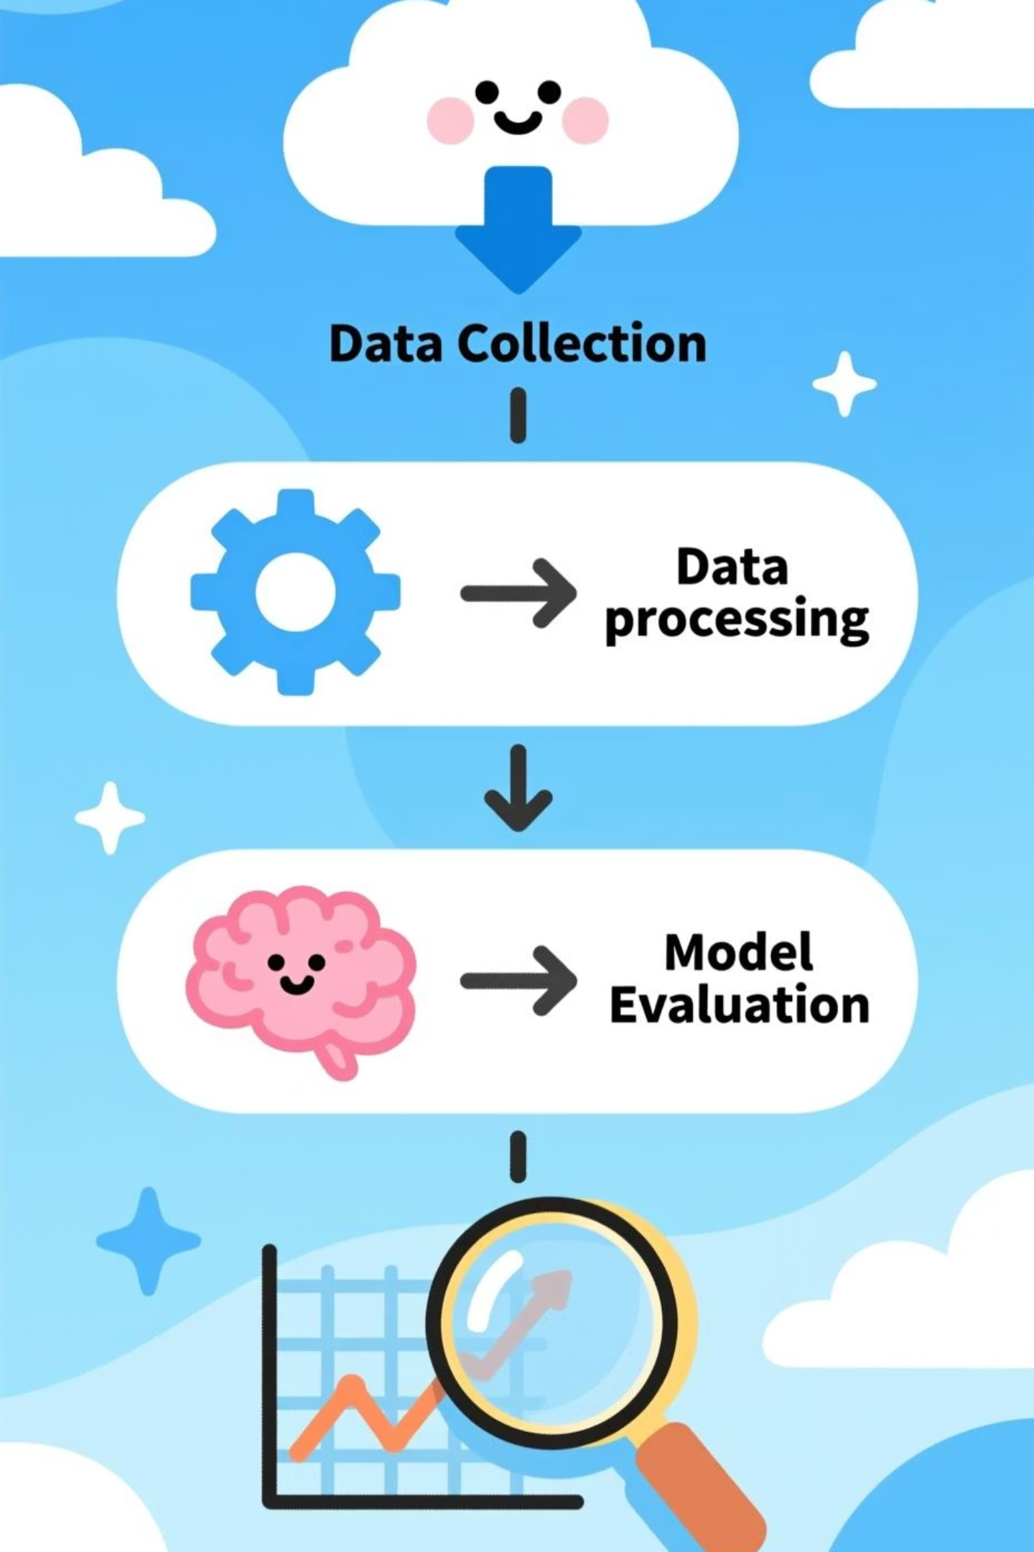
Training Pipeline: Four-Phase Approach
Phase 1: Self-Supervised Pretraining
BYOL(Bootstrap Your Own Latent (BYOL)) framework learns robust visual representations without labels
Phase 2: Supervised Multi-Task Fine-tuning
Joint learning of disease classification, health regression, and attention mechanism
Phase 3: Few-Shot Integration
Prototypical network enables rapid adaptation to unseen diseases with minimal examples
Phase 4: Mobile Optimization
TensorFlow Lite quantization and pruning for efficient edge device deployment
Page6

Slide 7
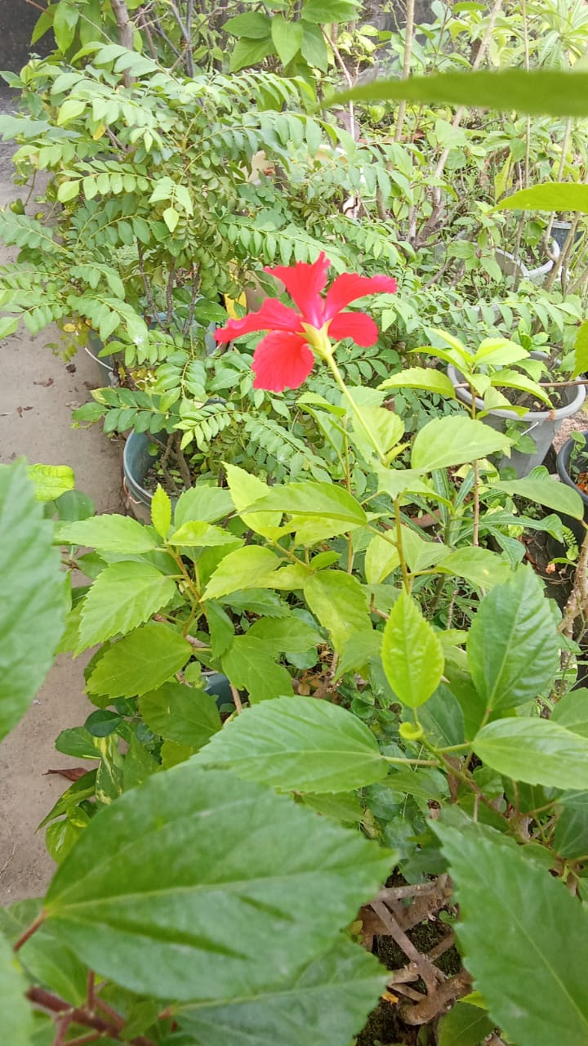
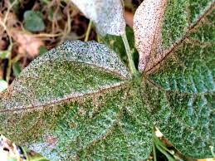
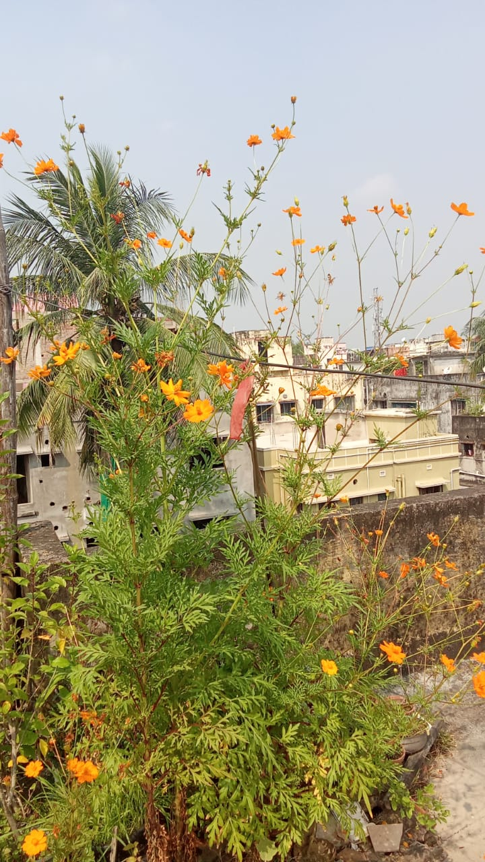
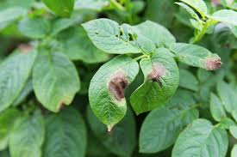
Dataset & Preprocessing
Data Sources: PlantVillage, Kaggle Plant Disease dataset, and home-collected images
Preprocessing Pipeline
Attention Map Generation
Train-Validation-Test Split
Resize → Normalize → Denoise → HSV segmentation with data augmentation (rotation, flipping, Gaussian noise)
Symptom-level annotations created for interpretability and supervised attention learning
70% training, 15% validation, 15% testing across all disease categories
Page7

Slide 8
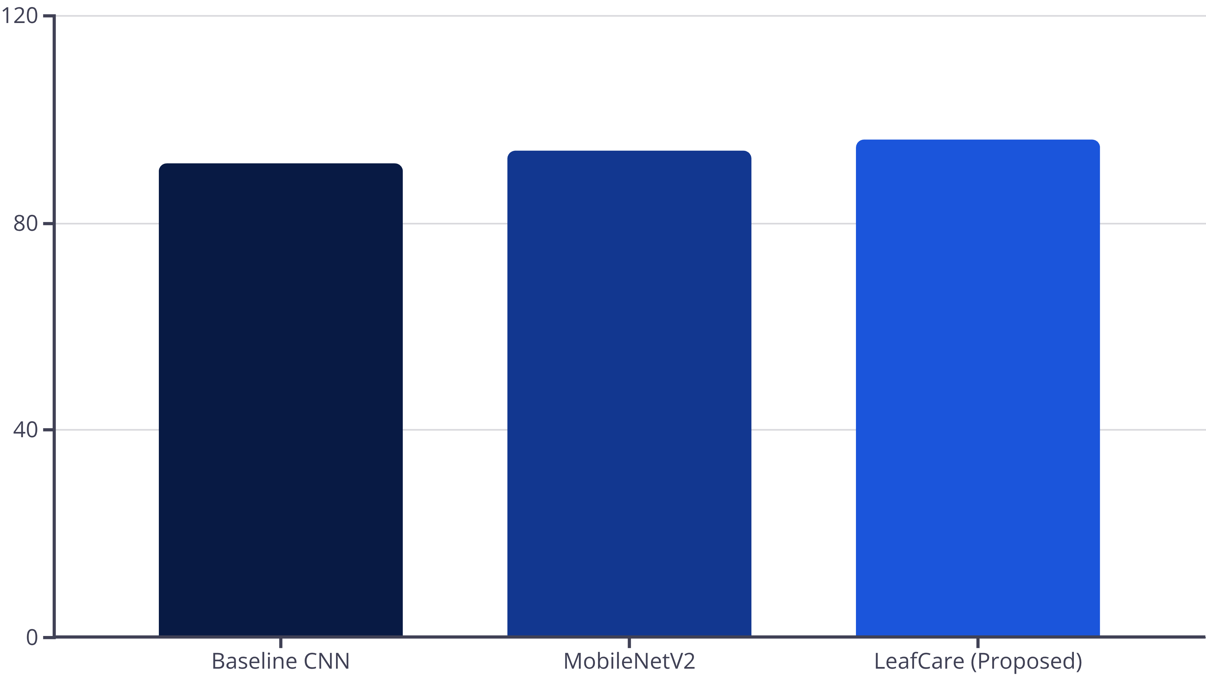
Performance Results
LeafCare achieves state-of-the-art performance :
96.2%
0.82
89%
Disease Classification Accuracy
IoU Score
Few-Shot Accuracy
Symptom-Attention CNN model
Disease localization precision
Detection with minimal examples
Page8

Slide 9
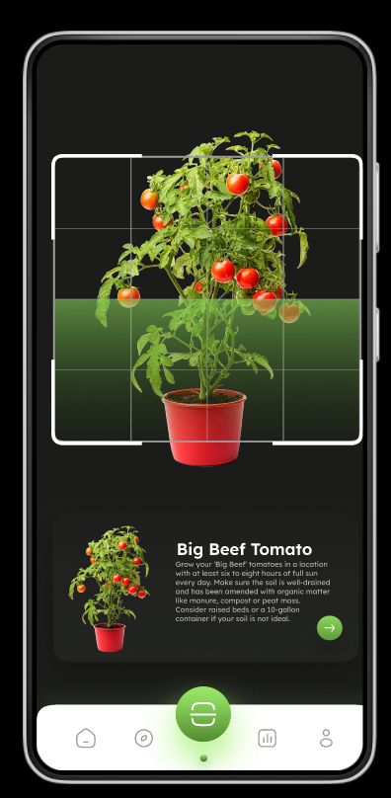
Conversational Assistant Integration
Context-aware NLP system provides personalized plant care guidance based on detected disease and environmental context.
NLP Technology
Example Interactions
How often should I water my tomatoes?
What is the best fertilizer for indoor succulents?
Why are my rose leaves turning yellow?
How can I prevent fungal diseases on my plants?
What causes white powdery spots on my leaves?
Model: SentenceTransformer (all-MiniLM-L6-v2)
Matching: Cosine similarity for FAQ retrieval
Context: Disease diagnosis + plant species
Scope: Care routines, remedies, prevention
Page9

Slide 10
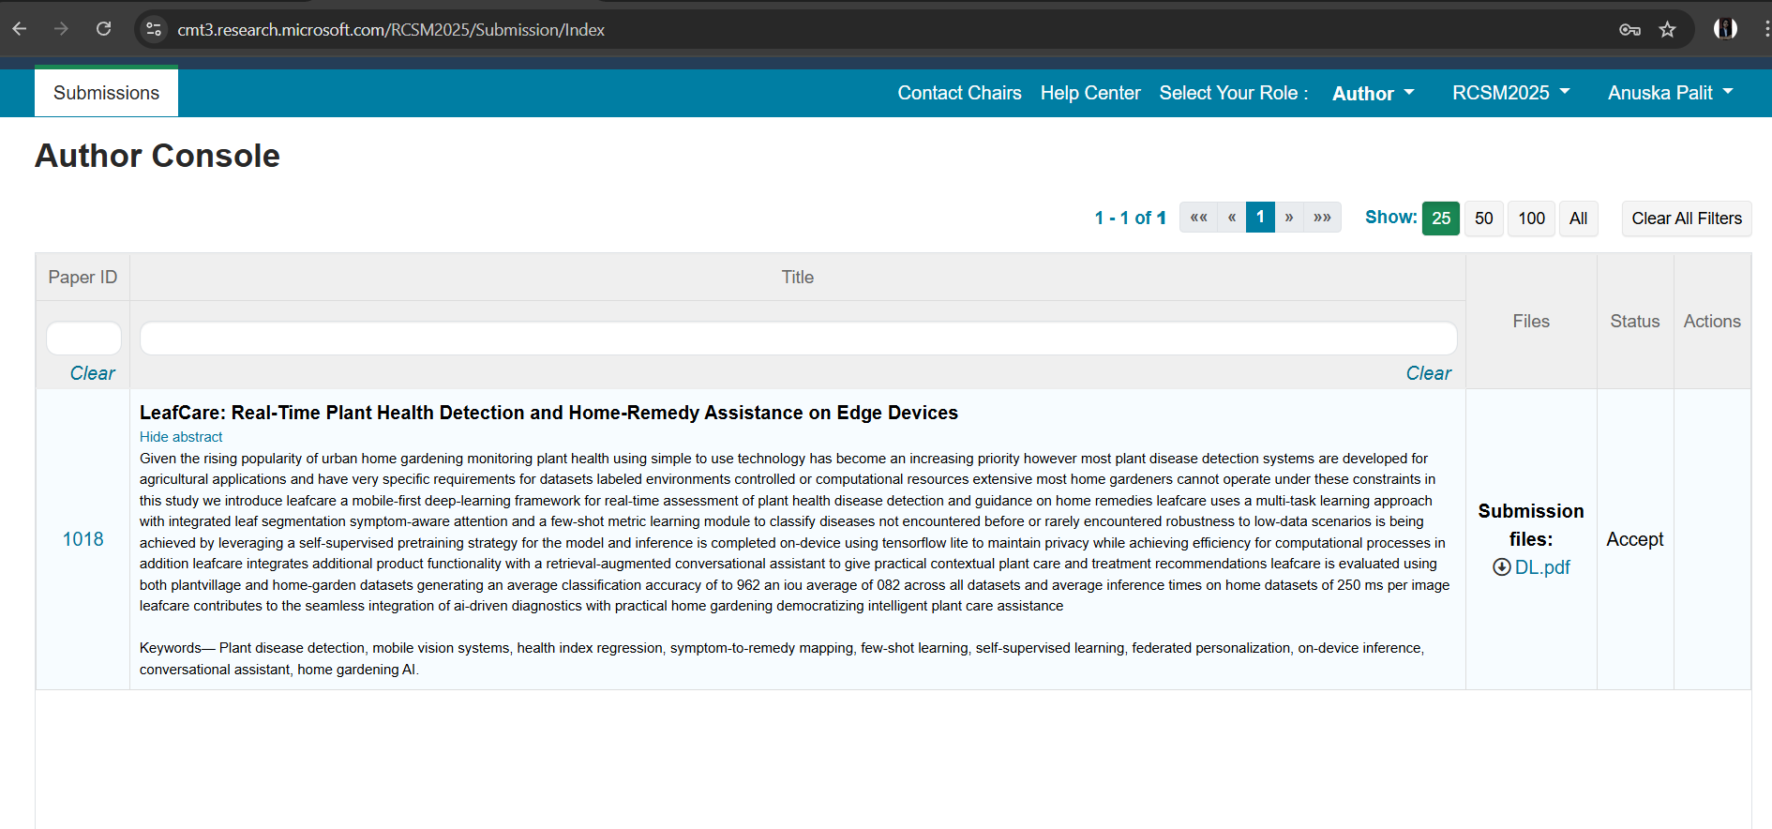
Recent Trends in Computing and Smart Mobility Conference. (Rcsm2025)

Slide 11
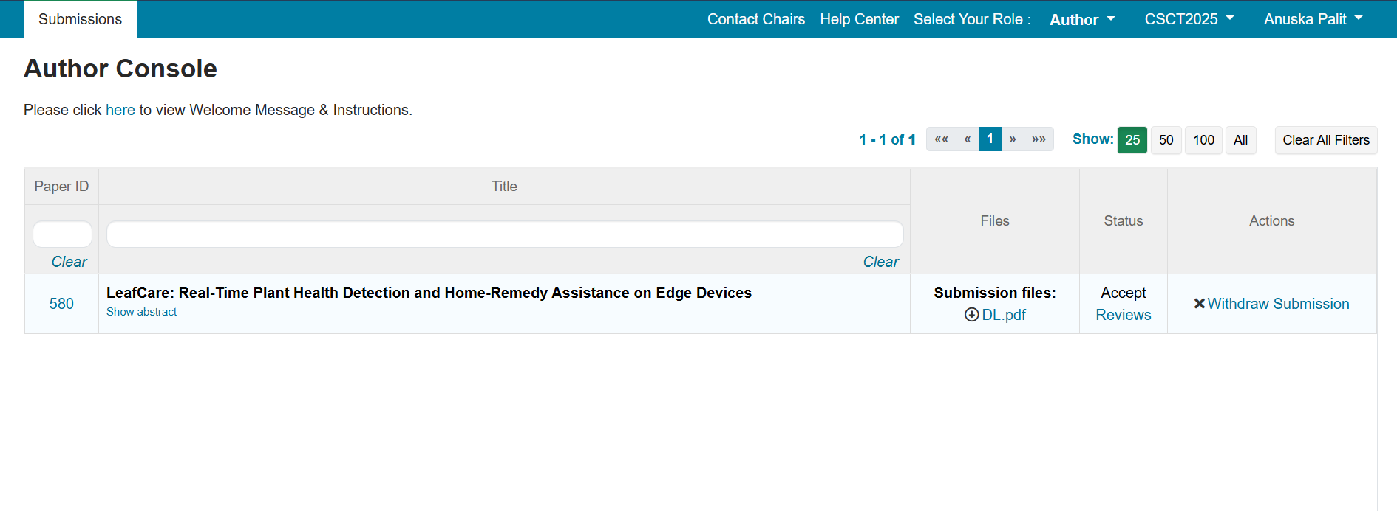
4th Congress on Smart Computing Technologies(CSCT 2025)

Slide 12
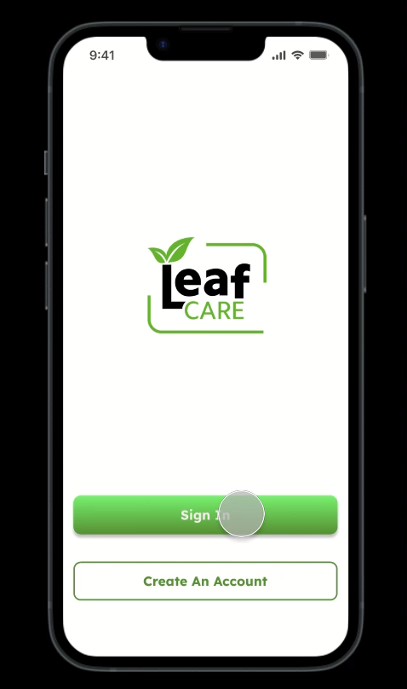
Experience how AI brings real-time plant health detection and personalized home care guidance to your fingertips..
Page11

Slide 13
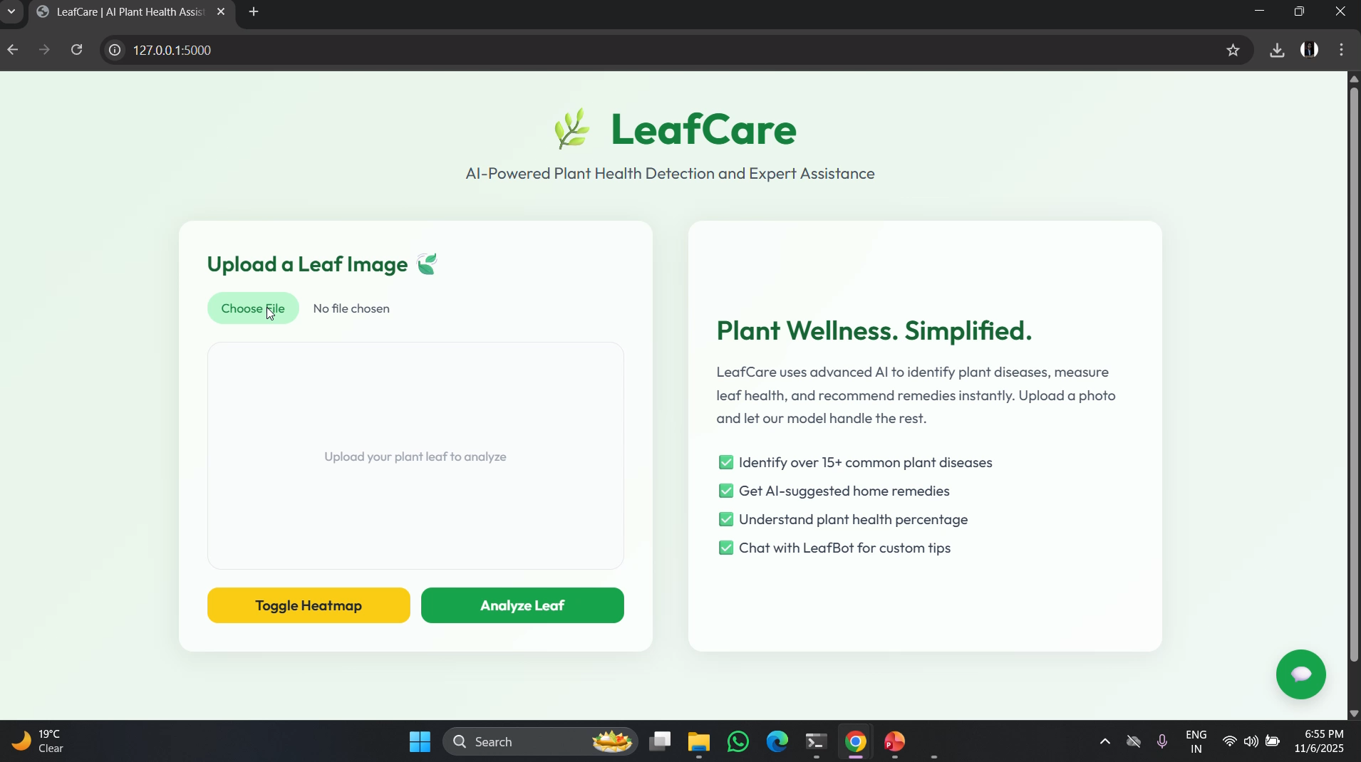
Page12

Slide 14
Conclusion & Future Directions
Key Achievements: LeafCare delivers an end-to-end intelligent system combining deep learning, few-shot adaptation, and NLP assistance—optimized for privacy-preserving edge deployment.
1
Current Impact
Democratized AI diagnostics for home gardeners with 96.2% accuracy and real-time mobile inference
2
Federated Learning
Multi-device personalization while preserving user privacy through on-device model updates
3
Multi-Modal Integration
Incorporate sensor data (humidity, temperature, soil moisture) for holistic plant health assessment
4
Explainable AI Enhancement
Advanced XAI techniques for deeper interpretability and user trust building
5
Urban Gardening Expansion
Support sustainable urban agriculture initiatives aligned with SDG 12 & 15
Page10

Slide 15
Thank You
Anuska Palit
12206089

